Slide 1
Creating an Altium Project Linked to Github Repo
By Sean Lam
Oct. 8, 2017

Slide 2
GITHUB & TORTOISE SVN

Slide 3
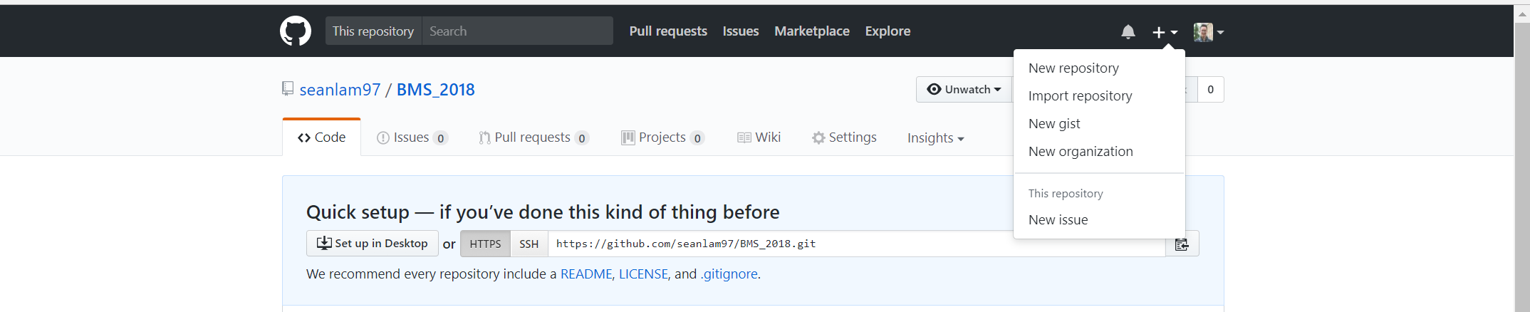
Generate a new repo with a README (or else things won’t work later on) Copy link to repo

Slide 4
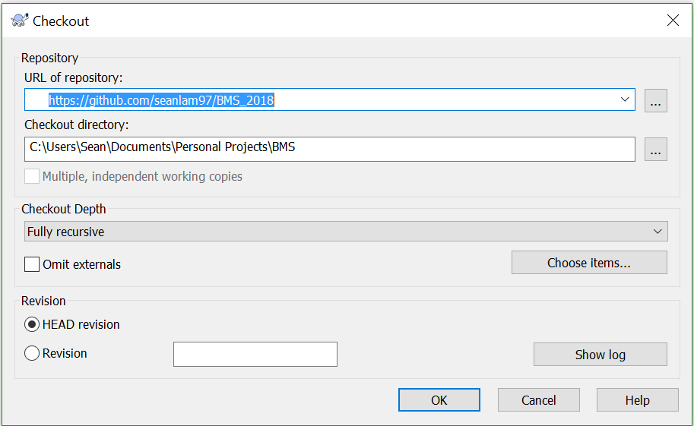
Create a folder in your local drive Enter that folder Checkout the new repo by pasting the link into the section URL of repository

Slide 5
Create some folder in your local drive Checkout the repo

Slide 6
ALTIUM

Slide 7
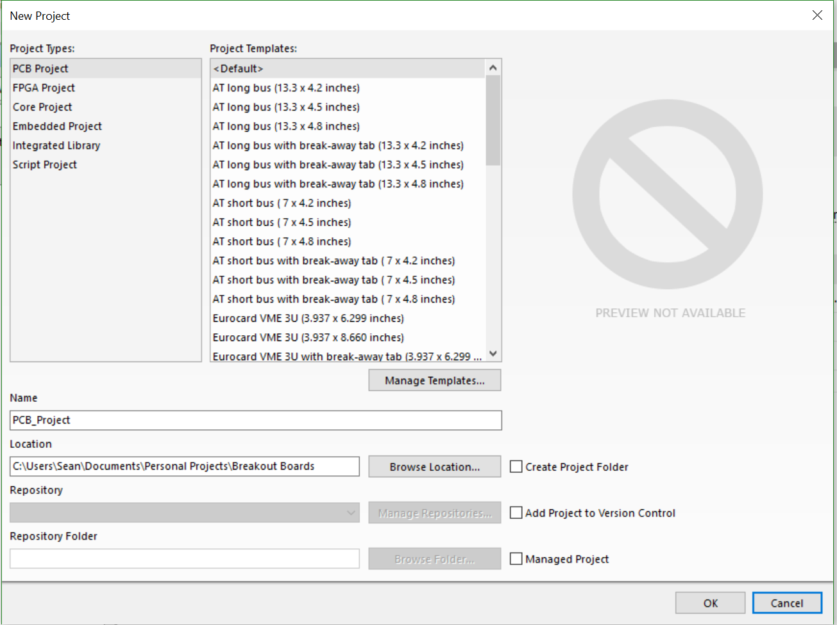
Create a new project

Slide 8
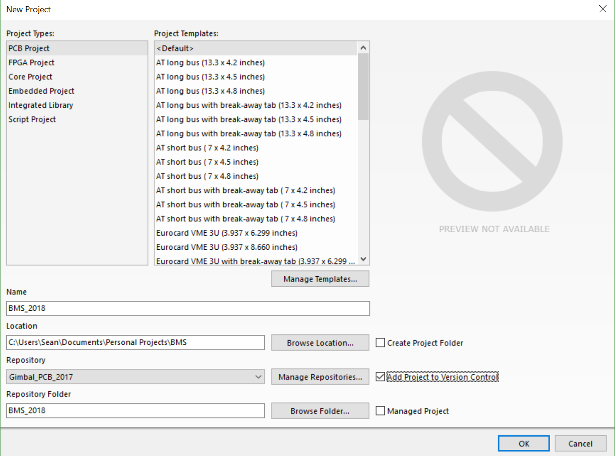
Check “Add Project to Version Control” Click on “Manage Repositories…”

Slide 9
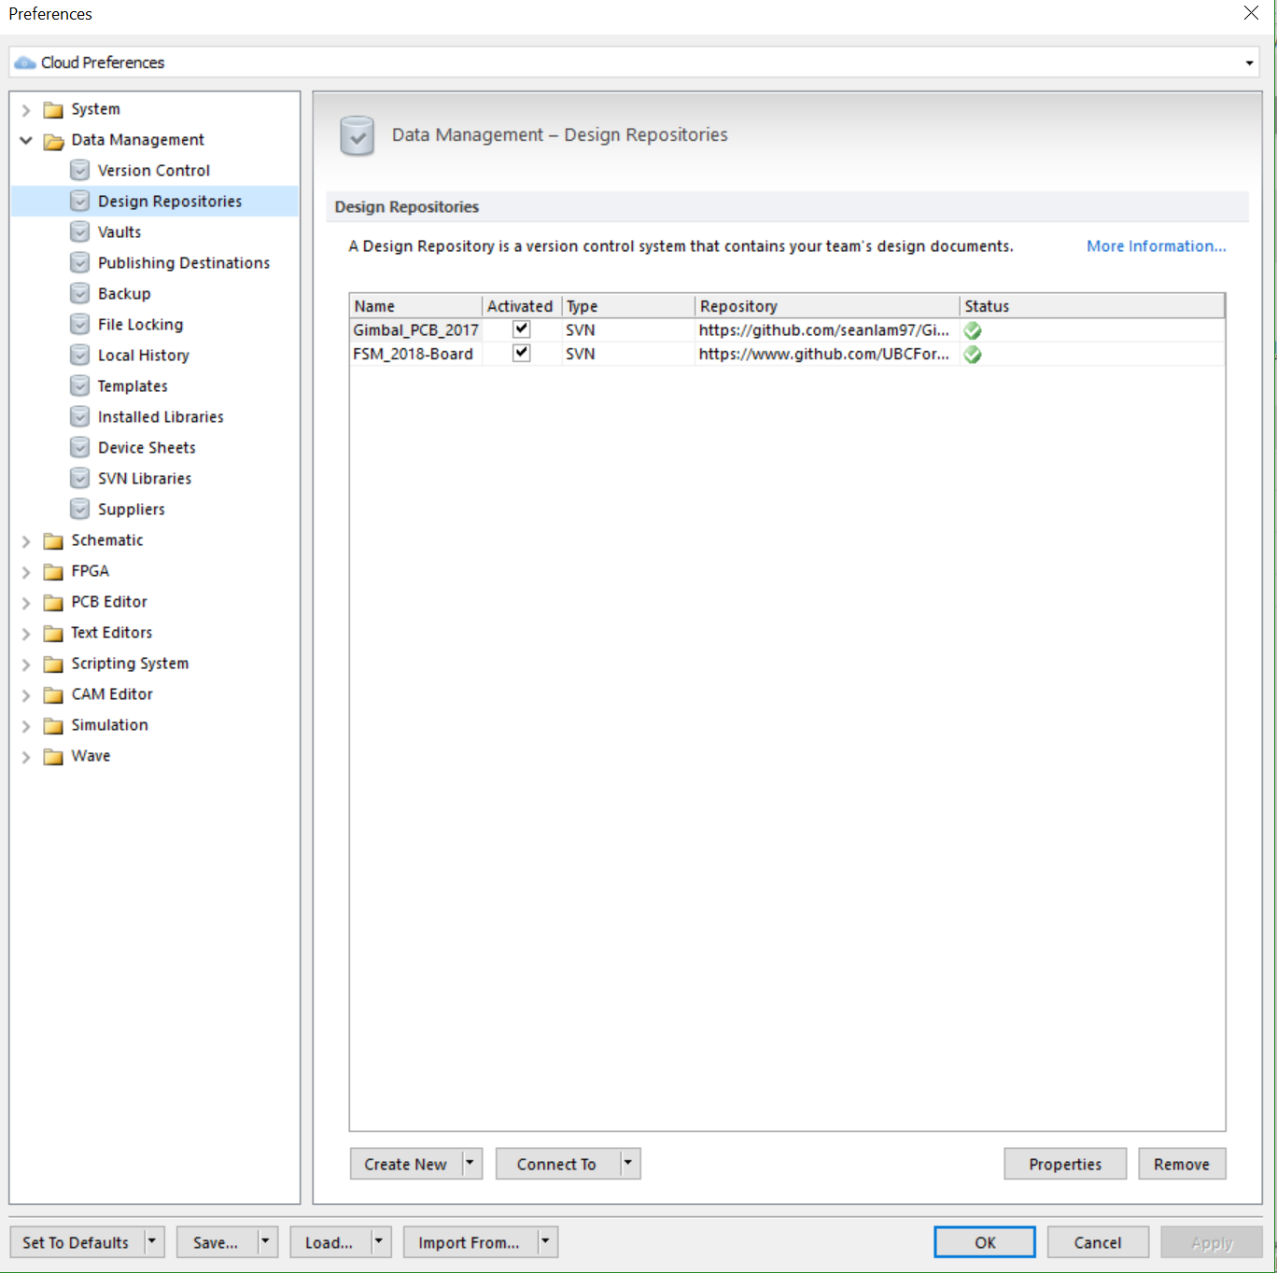
Click on the drop down menu on “Connect To” Click on “SVN”

Slide 10
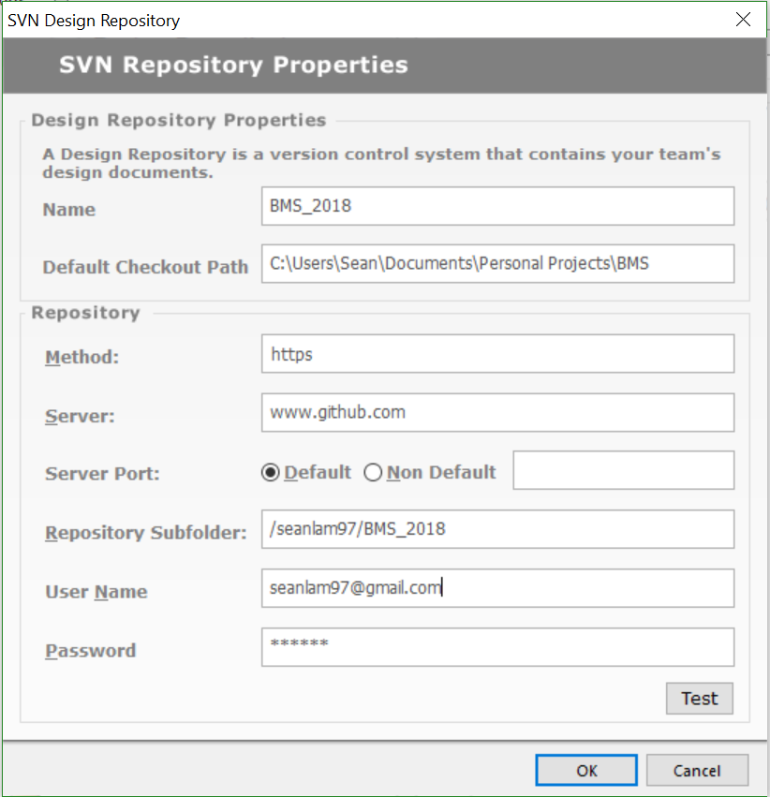
Fields Name: [Insert name of repo] Default Checkout Path: [Insert location of local folder] Method: https Server: www.github.com Server Port: [Check Default] Repository Subfolder: [Part of the link to the repo after www.github.com (i.e. if link to repo is https://github.com/seanlam97/BMS_2018 then Repository Subfolder = /seanlam97/BMS_2018) User Name: [Insert github username] Password: [Insert github password] Press “OK” when all filled

Slide 11
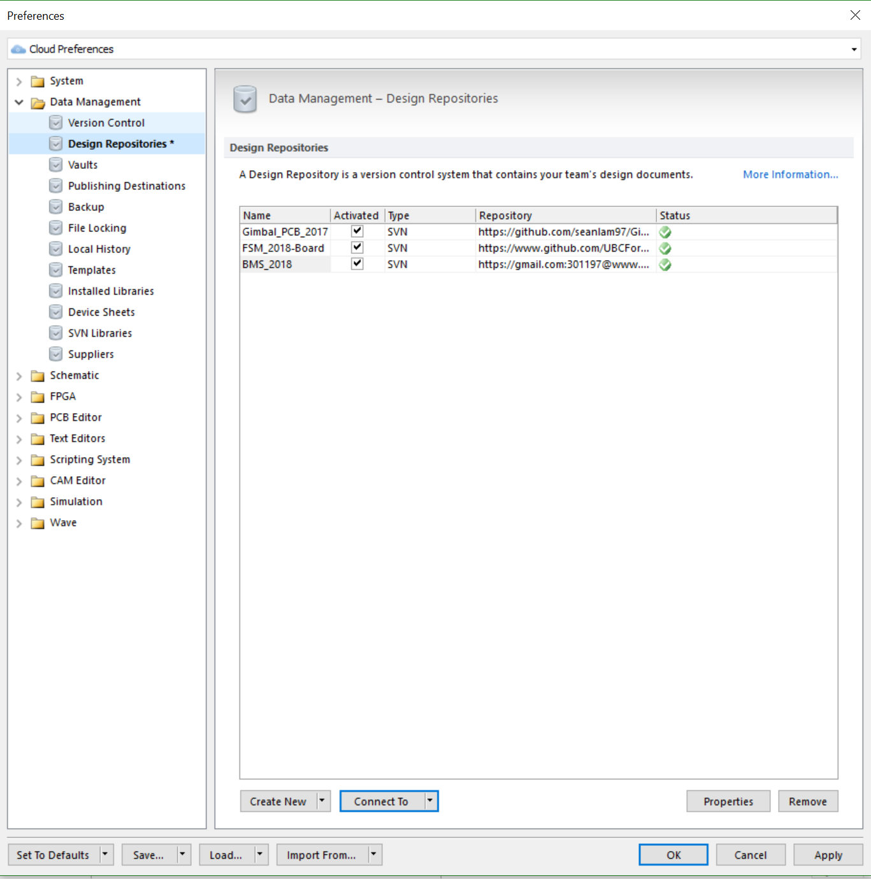
Now the repo is seen in Altium, Click “Apply” Click “OK”

Slide 12
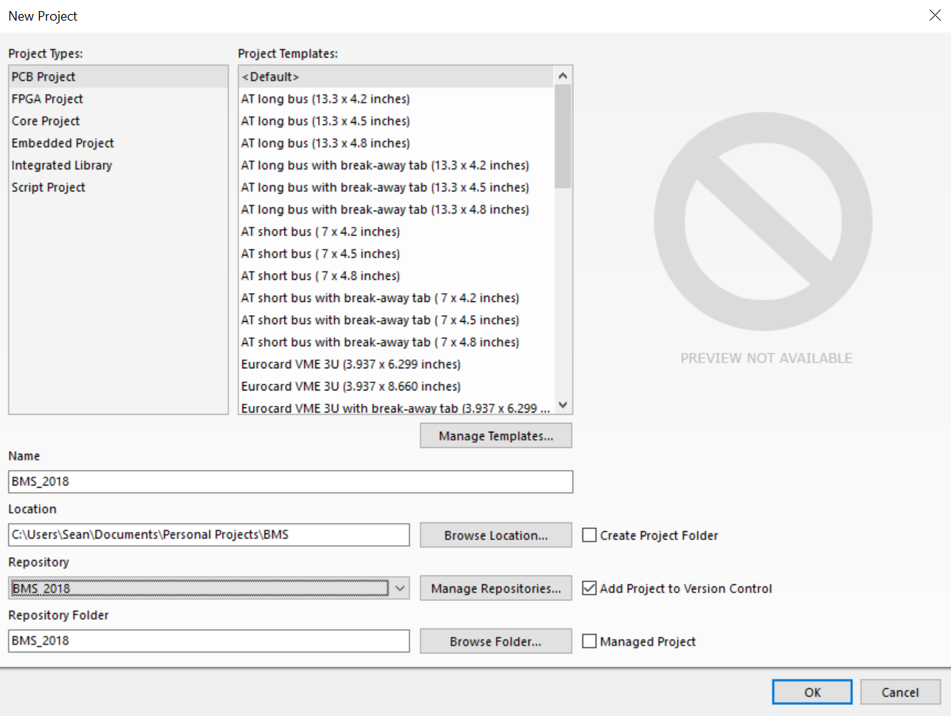
Select the correct repo under Repository in the drop down menu Then click “OK”

Slide 13
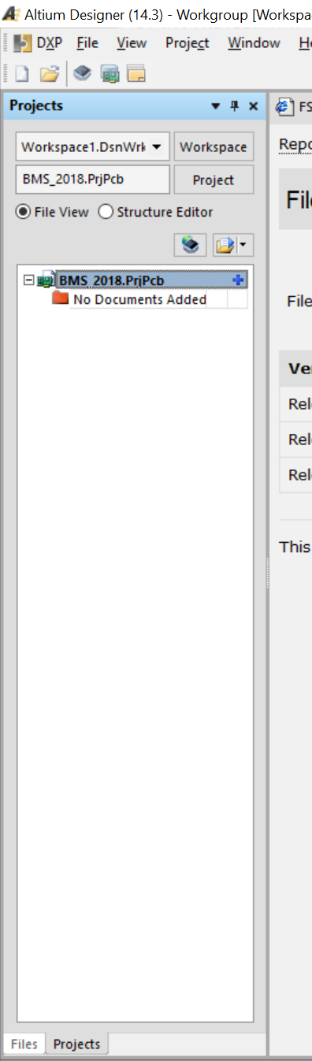
A new project should be created that is linked to the github repo Test it out by making a commit DONE! Maybe…

